Slide 1
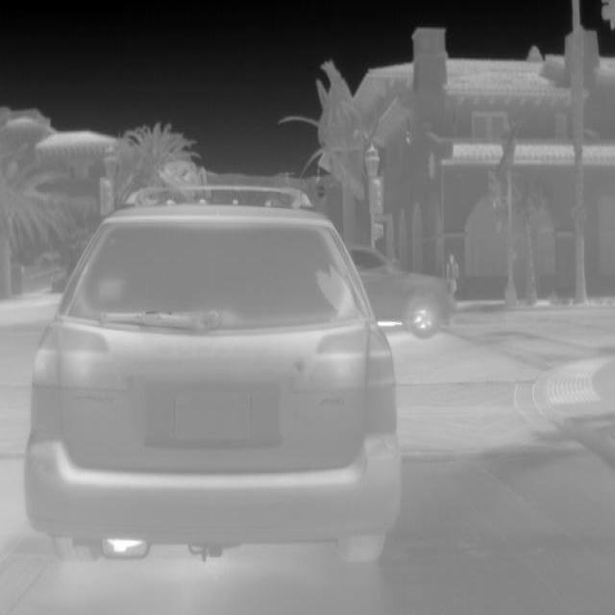
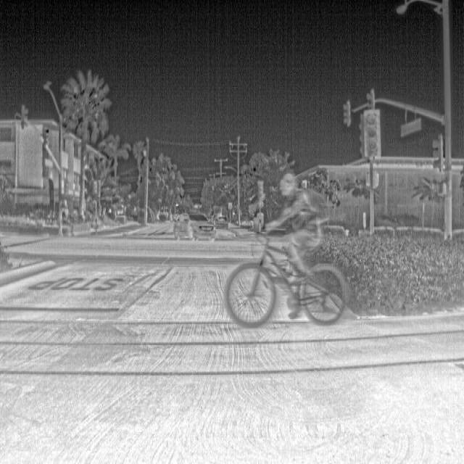
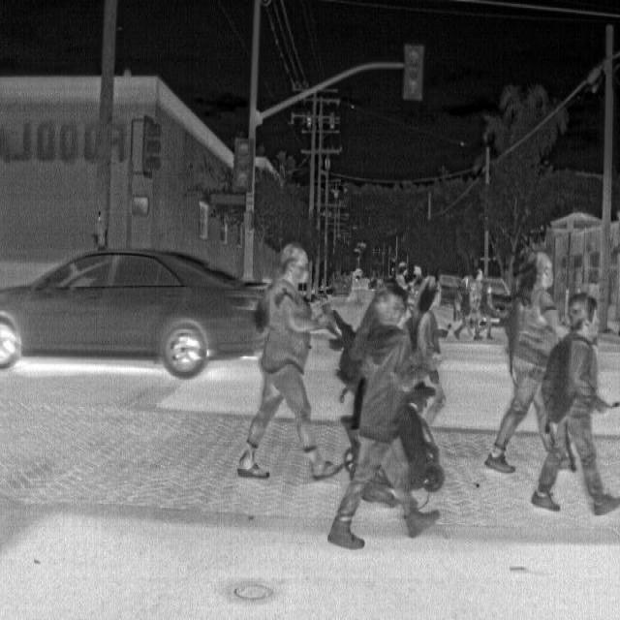
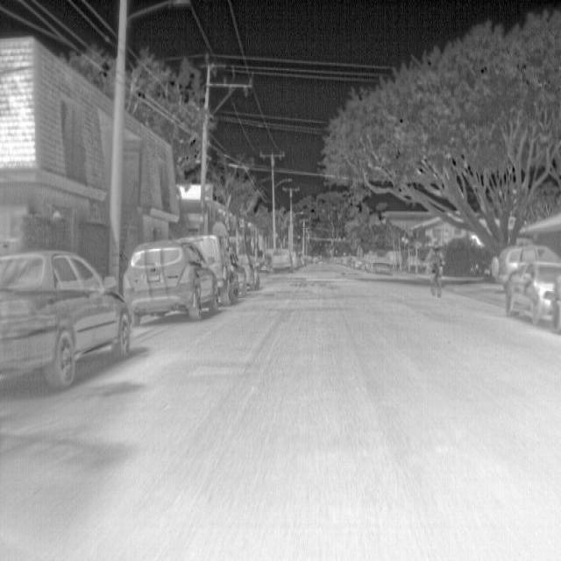
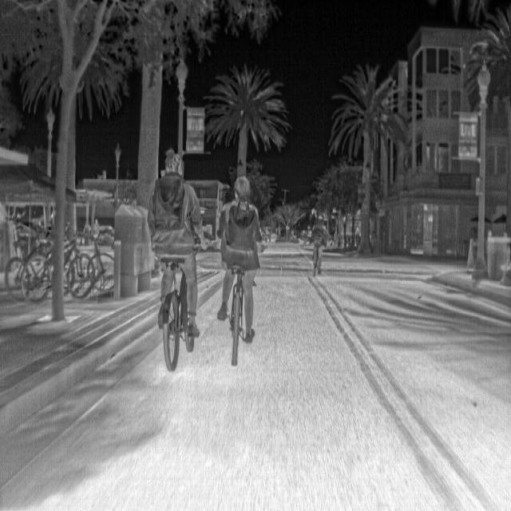
Pre-Processing
Input
Backbone
Neck
Head
Augmentation
Flipping
Rotation
Conv
CSP
CSP
CSP
Detect
Cropping
Scaling
Translation
Car
Dog
Neck
Person

